Slide 1

CRIMSON
history
A NEURAL STYLE TRANSFER SERVICE
snapshot
teams
timeline
about
AN IMPLEMENTATION BY TEAM EAGER BEAVER
SVVV INDORE

Slide 2
ABOUT
NEURAL STYLE TRANSFER
The concept of Neural Network takes it’s roots and firm foundation from the Concepts of Deep Learning and Data science.
It uses deep learning to compose images in the style of another image (ever wished you could paint like Picasso or Van Gogh?). This is known as neural style transfer!
Neural style transfer is an optimization technique used to take two images, a content image you want to style, a style reference image (such as an artwork by a famous painter), and blend them together such that the content image is transformed to look like the style reference image, but “painted” in the style of the style image.
teams
history
snapshot
timeline
about

Slide 3
ABSTRACT
CRIMSON
Crimson is a Deep Learning based venture launched by Eager Beaver , which focusses mainly over the red-hot technologies and practices such as facial-recognition , CNN , Styling of images using CNN-trained networks , Deep learning etc..
It captures the image using a webpage , performs facial-recognition and stores the image.
After storing the image it then stylizes the input image by blending it with a style reference image resulting in a stylized image.
snapshot
Abstract
teams
timeline
About

Slide 4
ALGORITHM USED
Perceptual Losses for Real-Time Style Transfer and Super-Resolution
We consider image transformation problems, where an input image is transformed into an output image.
Recent methods for such problems typically train feed-forward convolutional neural networks using a loss between the output and ground-truth images.
Parallel work has shown that high-quality images can be generated by defining and optimizing loss functions based on high-level features extracted from pretrained networks.
We combine the benefits of both approaches, and propose the use of perceptual loss functions for training feed-forward networks for image transformation tasks.
-BY Justin Johnson, Alexandre Alahi, Li Fei-Fei
snapshot
Abstract
teams
timeline
About
Algorithm

Slide 5
Language used, Libraries , Environment Used , H/W and S/W requirements.
Language Used : Python 3.6
Libraries Used : OpenCV2 , Numpy , Scipy , Matplotlib , Keras , Backend , PIL , Models , Image , Tensorflow
Environment Used : Jupyter notebook , Google Colab , Anaconda prompt.
Hardware Pre-requisite : Web-cam , GPU 2GB NVIDIA 520MX or above
Software Pre-requisite : Flask, Ubuntu 14.04 and above OS, Anaconda Python environment , Python 3.6 .
snapshot
teams
Abstract
timeline
About
Tools
Algorithm

Slide 6
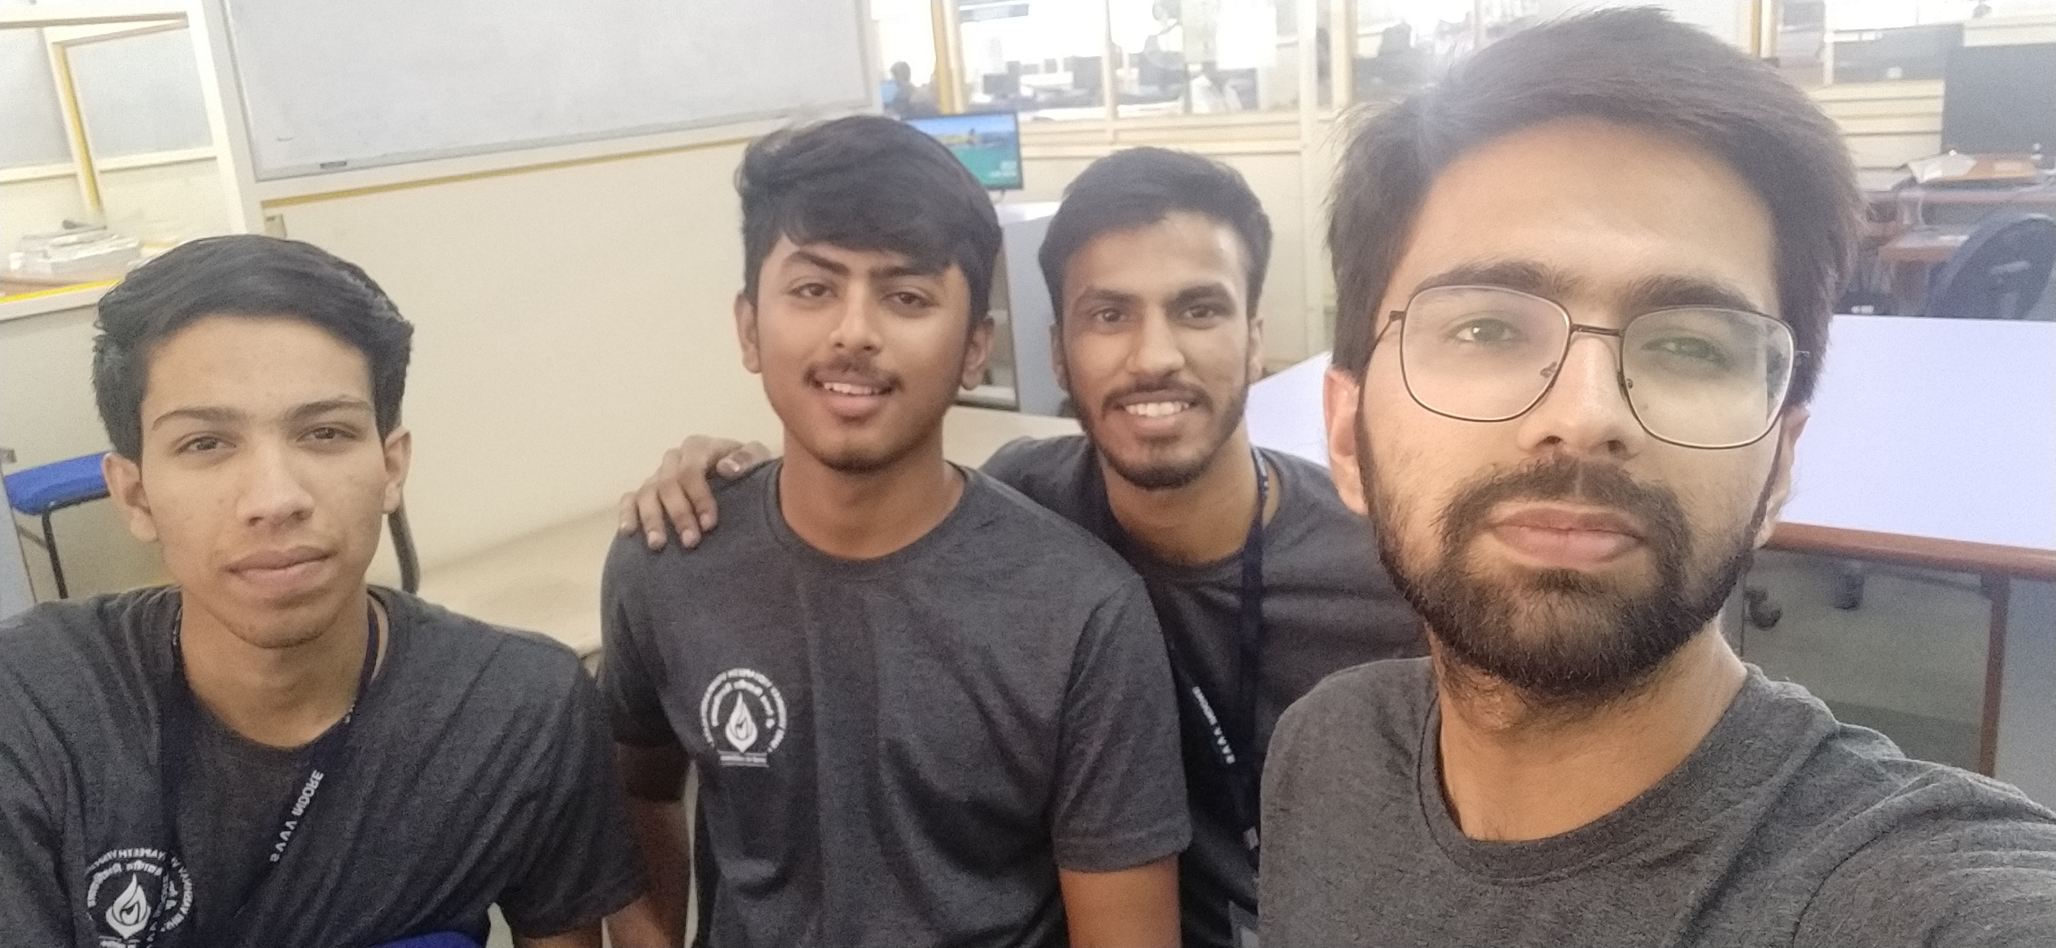
Snapshots !
Snapshot
teams
Abstract
timeline
About
Tools
Algorithm

Slide 7
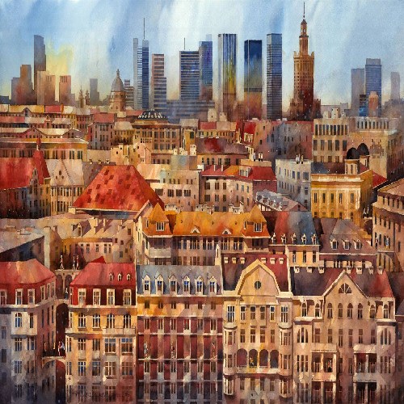
Snapshots !
Snapshot
teams
Abstract
timeline
About
Tools
Algorithm

Slide 8
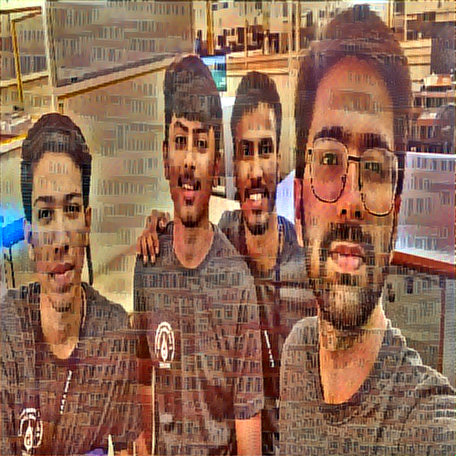
Snapshots !
Snapshot
teams
Abstract
timeline
About
Tools
Algorithm

Slide 9
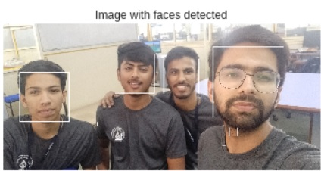
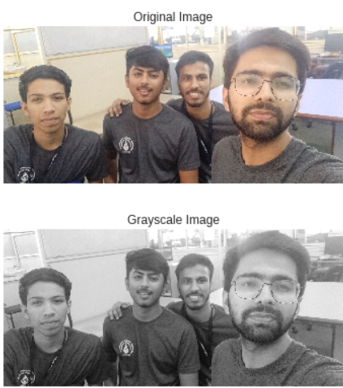
Snapshots !
Snapshot
teams
Abstract
timeline
About
Algorithm
Tools

